Slide 1
Your guide to presenting the value of your travel management program
Delete this slide before presenting.

Slide 2
Travel program leadership presentation
Update this slide before presenting.

Slide 3
Instructions
Delete this slide before presenting.
Update and personalize the slides from this template to relay to your leadership the value brought to your organization by managing travel with Amex GBT Select (SelectTM).
Throughout this template, you will find value placeholders and prompts for you to enter key messages and citations before use. Update numerical values for your company’s travel program using your SelectTM reporting tools, specifically Core Reporting. Where you see prompts to add commentary, assess your values against your company’s business goals and suggest next steps. Remember to remove highlights on these items before presenting.
For additional support, check the blue boxes for instructions to guide you to find key values in your reporting tool. Be sure to delete these before presenting.
Thank you for being a SelectTM customer!

Slide 4
One place for business travel spend
Spend is located on the Program Overview dashboard.
Tip: For more context, add breakouts by geography, class, and supplier.
Having centralized data improves visibility.
Booking all air, hotel, car, and rail reservations with SelectTM puts all of our travel data in one place for fast, accurate reporting and analysis so that we can make informed decisions.
Total Spend
$XX,XXX.XX
Air Spend
$XX,XXX.XX
Hotel Spend
$XX,XXX.XX
Car Spend
$XX,XXX.XX
Rail Spend
$XX,XXX.XX
Enter your key message / citation / next steps here

Slide 5
Policy compliance leads to savings
Hotel Attachment Rate is located on the Air Overview dashboard.
Tip: To support duty of care compliance, and to protect employee safety, an ideal hotel attachment rate is 100%.
Savings and Lost Savings are located on Savings Summary dashboard.
Tip: Look deeper into your data to identify source for lost savings.
The higher these percentages, the more potential we have to save.
Hotel Attachment
XX.XX%
of flights with an overnight stay in the destination have a hotel booked
Goal: 100%
Lowest Logical Airfare
XX.XX%
of flights were booked at the lowest logical airfare
Savings: $XXX.XX
Lost Savings: $XXX.XX
Advanced Air Booking
XX.XX%
of flights were booked 14 days or more ahead of the trip start date
Savings: $XXX.XX
Lost Savings: $XXX.XX
Enter your key message / citation / next steps here

Slide 6
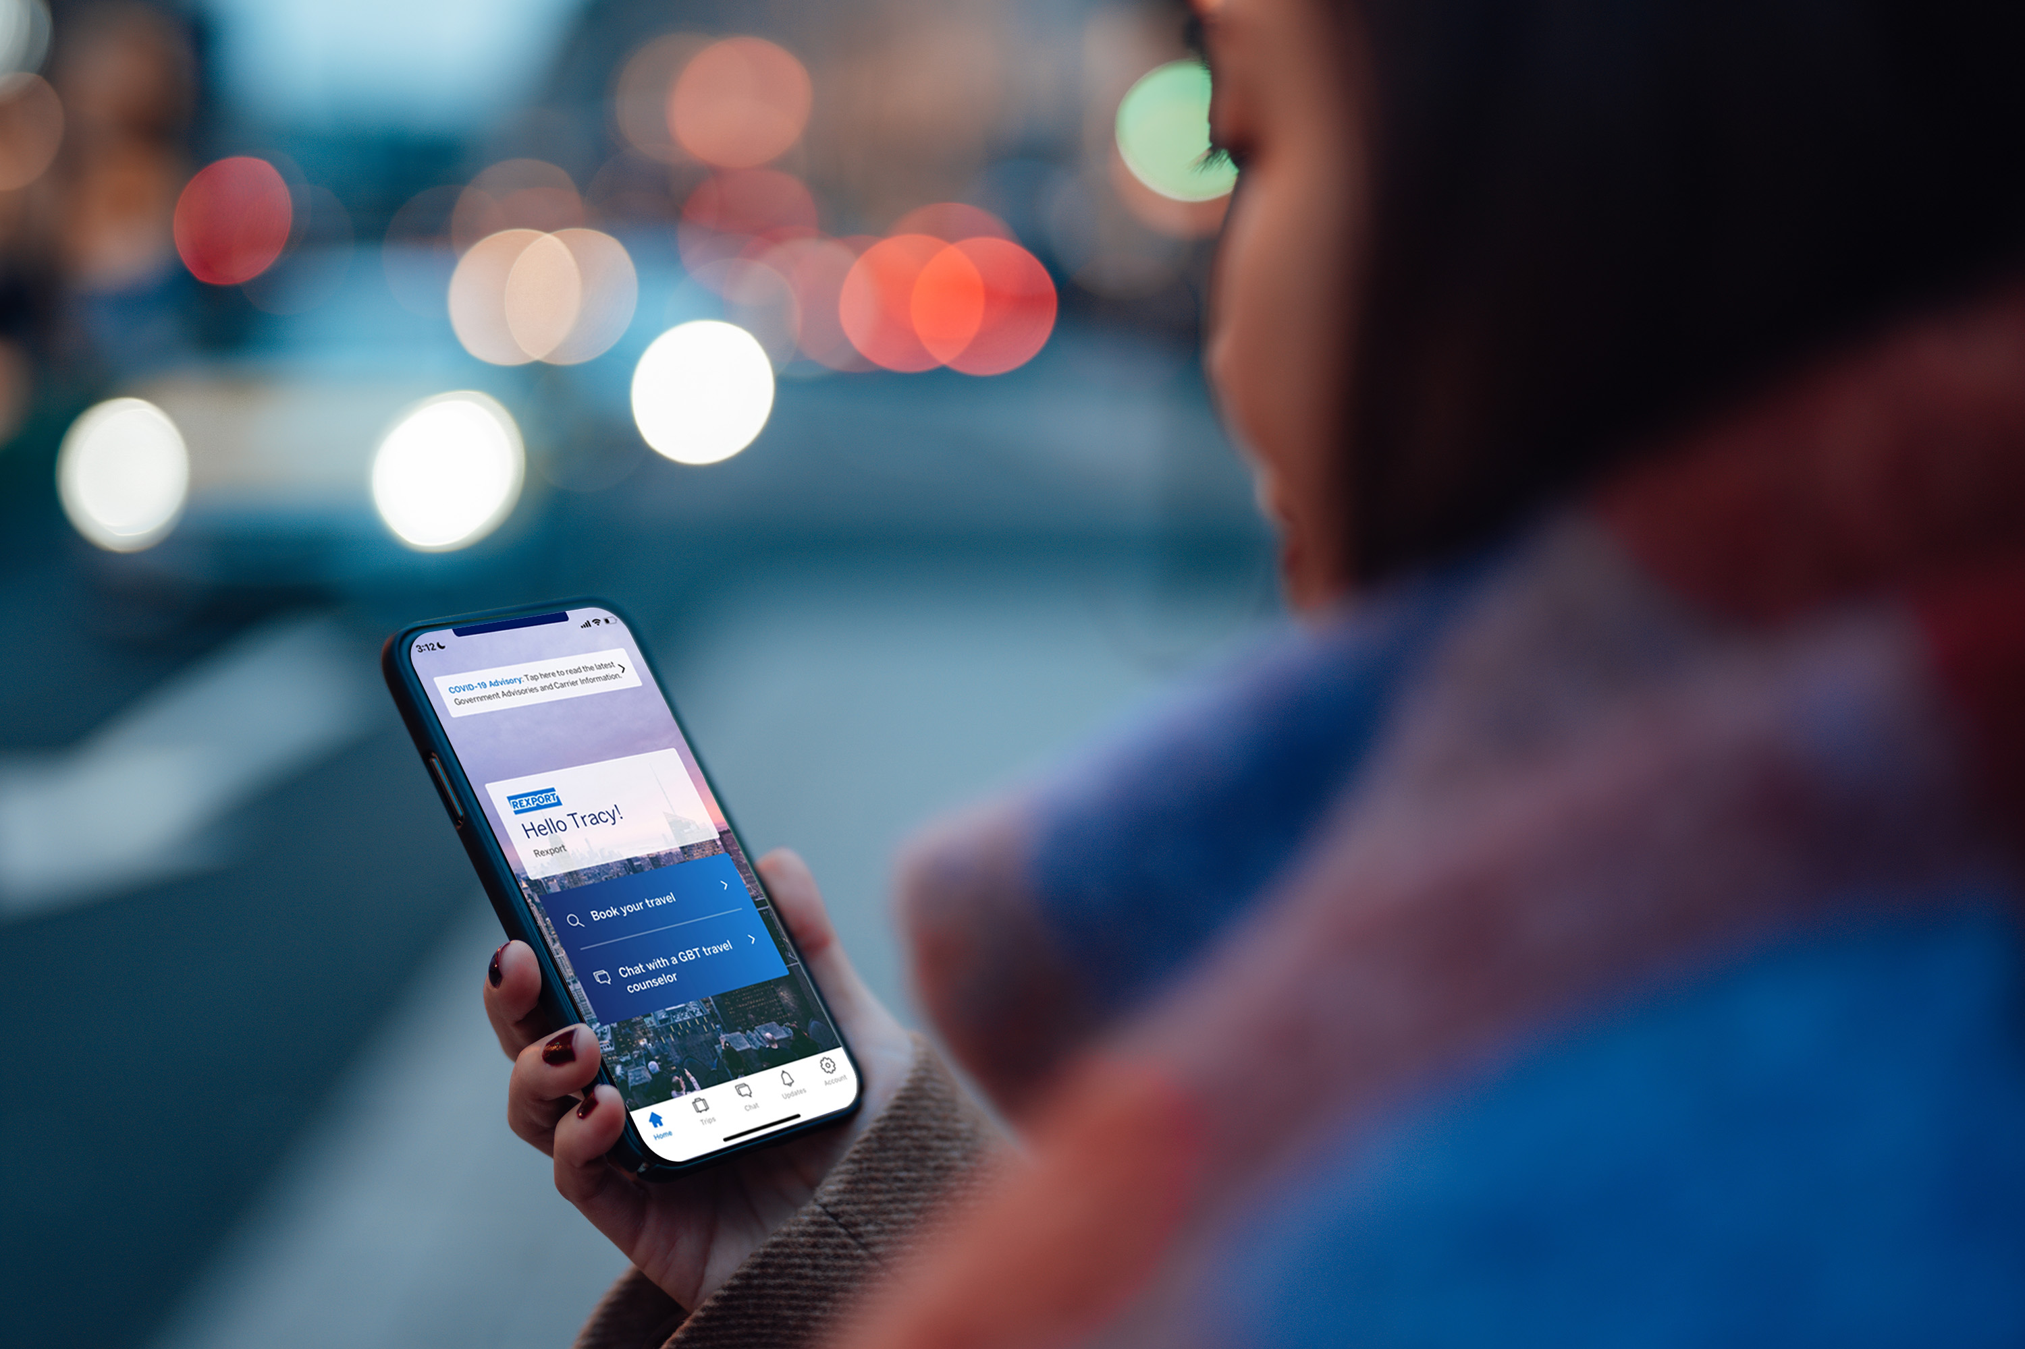
Manage travel on the Amex GBT Mobile app
Personalized trip management on the go.
The Amex GBT Mobile app helps our business travelers manage their trip end-to-end and in real-time.
Key features include:
24/7 chat with travel counselors.
Travel disruption notifications.
Up-to-date departure/arrival times.
Gate location information.
Ability to share their itinerary.
View of flight, hotel & ground transportations.
View of flight carbon emissions.
Enter your key message / citation / next steps here

Slide 7
Proactive Traveler Care™
Assists travelers during flight disruptions to avoid negative costs and minimize hassle.
Checks for disruptions
  Monitors flight cancellations, long delays, and potential missed connections.
Communicates with traveler
  Automatically sends a message to our traveler proactively asking if they require assistance (via email, SMS and the Amex GBT Mobile app).
Rebooks travel
An American Express Global Business Travel (Amex GBT) travel counselor rebooks the traveler's trip.
Enter your key message / citation / next steps here

Slide 8
We benefit overall
Contact your Amex GBT Select account manager to learn about how to increase savings with your current setup, as well as explore additional options solutions that may be available to you.
SelectTM brings value to our company as well as our travelers.
Benefits for our company:
Centralized travel data improves spend visibility.
Useful reports identify savings and safety opportunities.
In-place methods improve policy compliance and support our Duty of Care.
Benefits for our travelers:
On-the-go support from the Amex GBT Mobile app keeps travelers organized and able to reach travel counselors 24/7.
Proactive rebooking assistance gets travelers re-routed quickly during flight disruptions.
Travelers can include loyalty programs on their profiles to earn points and perks.

Slide 9
Thank you

